Slide 1
Moving Object Detection Revisited
(Texture + Color) based method
- PULKIT PRAKASH

Slide 2
Problems with previous Models?
Moving cast shadow problem
Detection boundary is coarse
Adjacent moving objects tend to be connected
Multi Histogram models are time consuming

Slide 3
New Strategy…
Fusion of Color & Texture, to handle illumination variation and smooth background-foreground problem
Single histogram model is established for each block, to speed up process and for less consumption of memory. Also, it can handle dynamic background and multi-modal problem
Two levels of block sizes are used, to achieve more accurate foreground detection
A new quality measure is designed, to detect different moving objects separately without breaking

Slide 4
BLOCKWISE BACKGROUND MODEL BASED ON TEXTURE INFORMATION

Slide 5
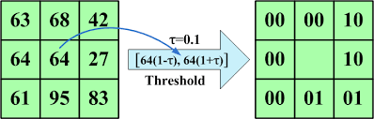
SILTP(scale invariant local ternary pattern)
Fig: Calculating the SILTP code

Slide 6
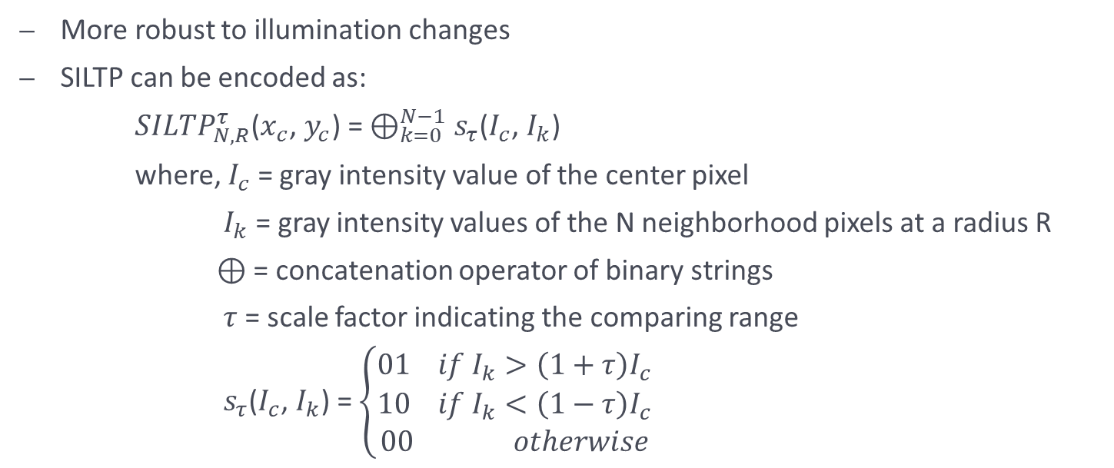
More robust to illumination changes
SILTP can be encoded as:
${SILTP}_{N,R}^{τ}$($x_{c}$, $y_{c}$) = $⊕_{k=0}^{N−1}$ $s_{τ}$($I_{c}$, $I_{k}$)
where, $I_{c}$ = gray intensity value of the center pixel
$I_{k}$ = gray intensity values of the N neighborhood pixels at a radius R
$⊕$ = concatenation operator of binary strings
$τ$ = scale factor indicating the comparing range
$s_{τ}$($I_{c}$, $I_{k}$) = $\left\{\begin{aligned}01 if I_{k}>\left(1+τ\right)I_{c} \\ 10 if I_{k}<\left(1−τ\right)I_{c} \\ 00 otherwise\end{aligned}\right.$

Slide 7
Block-based method
We develop a two-level block size strategy
Each image is divided into small blocks: four small blocks form a big block, while big blocks are partially overlapping
Background model is calculated for each big block but final foreground detection is made according to small blocks
Advantages:
-> Background model from big block is more stable
-> Partially overlapping technique is able to obtain more information than non-overlapping technique
-> Detection of foreground from small blocks is more fine

Slide 8
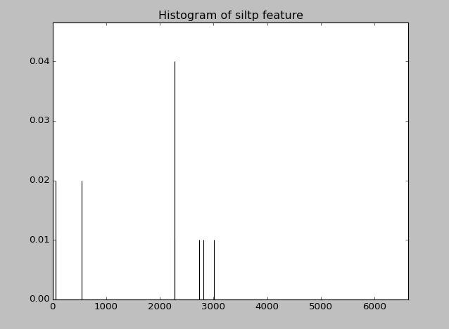
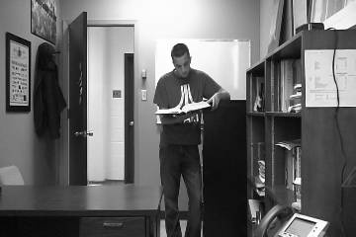
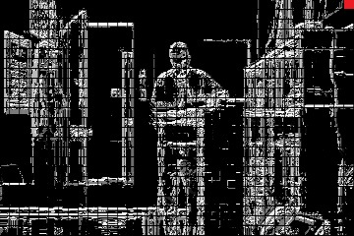
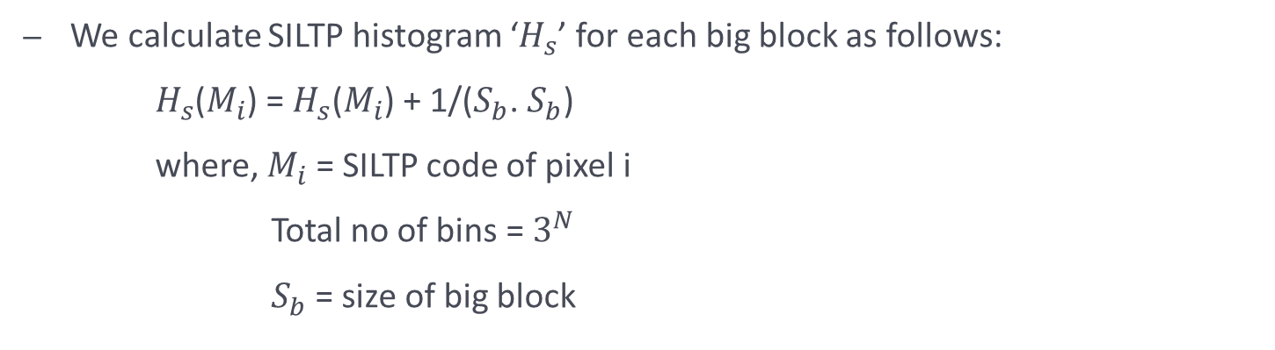
We calculate SILTP histogram ‘$H_{s}$’ for each big block as follows:
$H_{s}$($M_{i}$) = $H_{s}$($M_{i}$) + 1/($S_{b}$. $S_{b}$)
where, $M_{i}$ = SILTP code of pixel i
Total no of bins = $3^{N}$
$S_{b}$ = size of big block
SILTP histogram of highlighted block
Original image
SILTP image (after converting into gray scale)

Slide 9
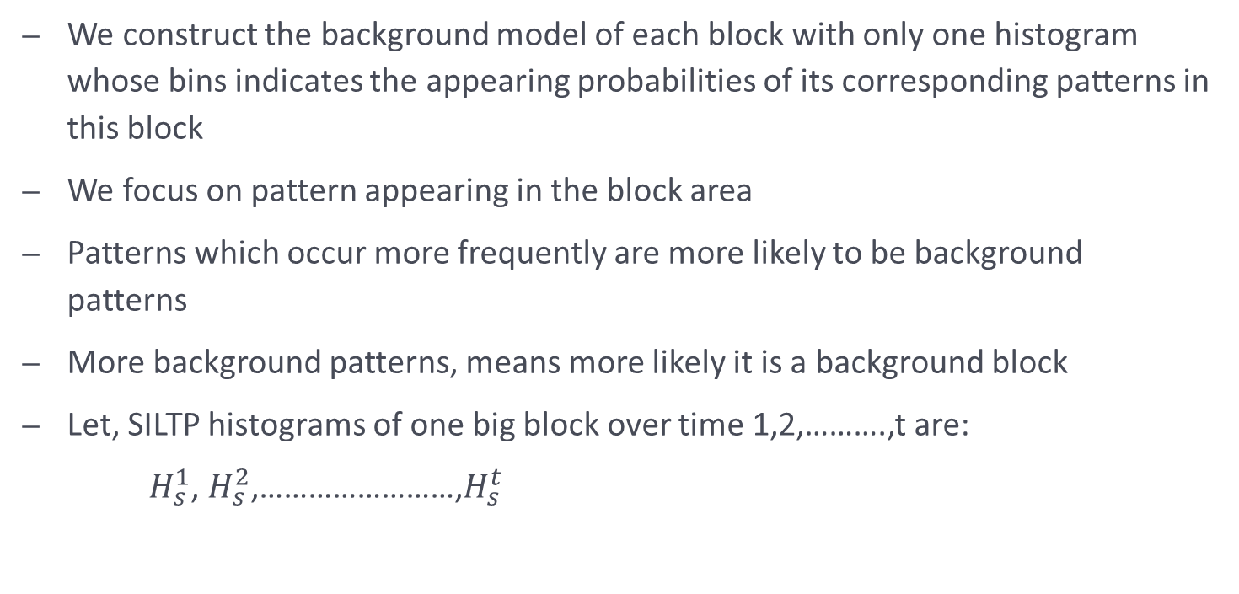
Background Modelling
We construct the background model of each block with only one histogram whose bins indicates the appearing probabilities of its corresponding patterns in this block
We focus on pattern appearing in the block area
Patterns which occur more frequently are more likely to be background patterns
More background patterns, means more likely it is a background block
Let, SILTP histograms of one big block over time 1,2,……….,t are:
$H_{s}^{1}$, $H_{s}^{2}$,……………………,$H_{s}^{t}$

Slide 10

Suppose background model histograms of same big block over time 1,2,………,t are:
$B_{s}^{0},B_{s}^{1}$, $B_{s}^{2}$,……………………,$B_{s}^{t}$
where, $B_{s}^{0}$ = initial value of $B_{s}$ having each bin value equal to (1/$3^{N})$
Then, we update the $B_{s}^{t}$ as follows:
$B_{s}^{t}$(i) = (1-$α$).$B_{s}^{t−1}$(i) + $α.H_{s}^{t}$(i)
where, $α$ = learning rate

Slide 11
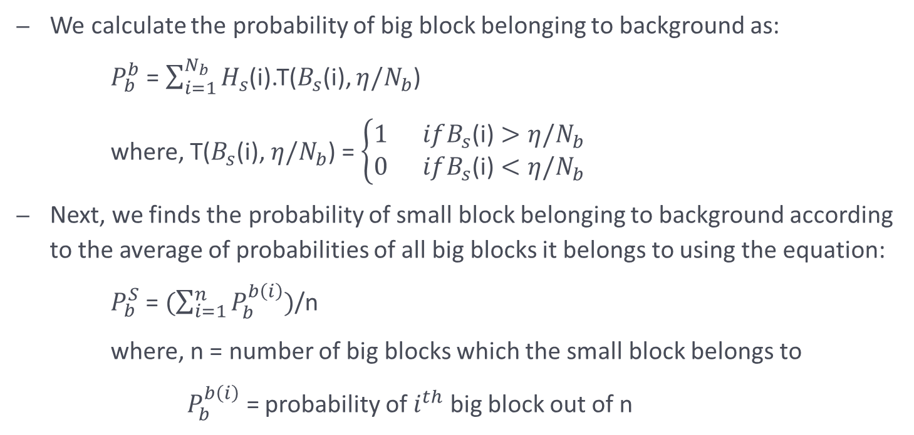
Foreground Detection
We calculate the probability of big block belonging to background as:
$P_{b}^{b}$ = $\sum_{i=1}^{N_{b}}{H_{s}}$(i).T($B_{s}$(i), $η/N_{b}$)
where, T($B_{s}$(i), $η/N_{b}$) = $\left\{\begin{aligned}1 ifB_{s}\text{(}\text{i}\text{)}>η/N_{b} \\ 0 ifB_{s}\text{(}\text{i}\text{)}<η/N_{b}\end{aligned}\right.$
Next, we finds the probability of small block belonging to background according to the average of probabilities of all big blocks it belongs to using the equation:
$P_{b}^{S}$ = $(\sum_{i=1}^{n}{P_{b}^{b\left(i\right)}})$/n
where, n = number of big blocks which the small block belongs to
$P_{b}^{b\left(i\right)}$ = probability of $i^{th}$ big block out of n

Slide 12
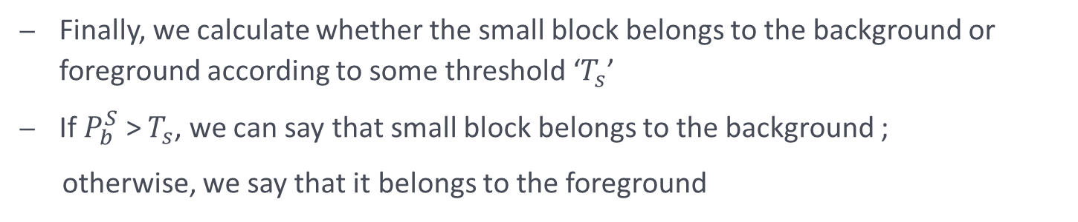
Finally, we calculate whether the small block belongs to the background or foreground according to some threshold ‘$T_{s}$’
If $P_{b}^{S}$ > $T_{s}$, we can say that small block belongs to the background ;
otherwise, we say that it belongs to the foreground

Slide 13
BLOCKWISE BACKGROUND MODEL BASED ON COLOR INFORMATION

Slide 14
Advantages of color model…
Can deal with smooth surfaces easily, such as:
-> roads
-> body of cars
-> pedestrians with single-color clothes
Also proves useful in cases when most of the patterns of foreground parts belong to dominant background patterns but only have a different distribution

Slide 15
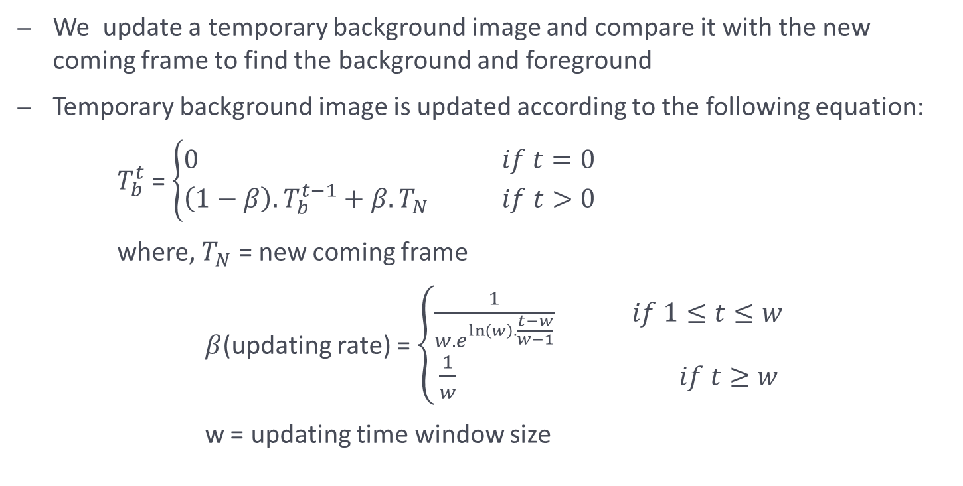
Temporary Background Image updating
We update a temporary background image and compare it with the new coming frame to find the background and foreground
Temporary background image is updated according to the following equation:
$T_{b}^{t}$ = $\left\{\begin{aligned}0 if t=0 \\ \left(1−β\right).T_{b}^{t−1}+β.T_{N} if t>0\end{aligned}\right.$
where, $T_{N}$ = new coming frame
$β$(updating rate) = $\left\{\begin{aligned}\frac{1}{w{.e}^{\ln\left(w\right).\frac{t−w}{w−1}}} if 1≤t≤w \\ \frac{1}{w} if t≥w\end{aligned}\right.$
w = updating time window size

Slide 16
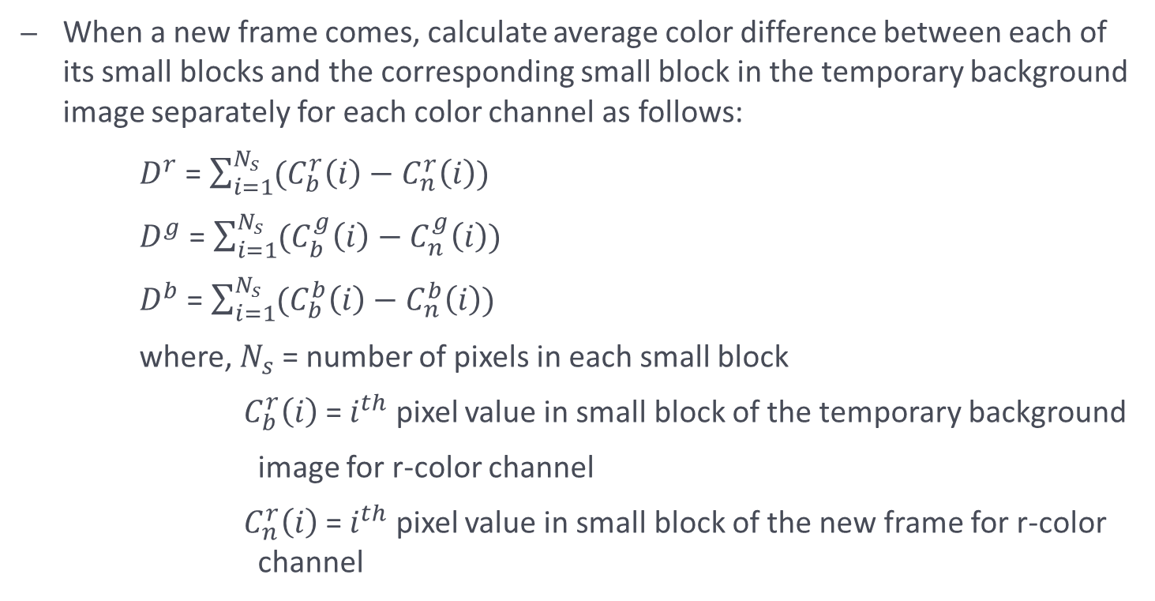
Foreground detection
When a new frame comes, calculate average color difference between each of its small blocks and the corresponding small block in the temporary background image separately for each color channel as follows:
$D^{r}$ = $\sum_{i=1}^{N_{s}}{(C_{b}^{r}\left(i\right)−C_{n}^{r}\left(i\right))}$
$D^{g}$ = $\sum_{i=1}^{N_{s}}{(C_{b}^{g}\left(i\right)−C_{n}^{g}\left(i\right))}$
$D^{b}$ = $\sum_{i=1}^{N_{s}}{(C_{b}^{b}\left(i\right)−C_{n}^{b}\left(i\right))}$
where, $N_{s}$ = number of pixels in each small block
$C_{b}^{r}\left(i\right)$ = $i^{th}$ pixel value in small block of the temporary background
image for r-color channel
$C_{n}^{r}\left(i\right)$ = $i^{th}$ pixel value in small block of the new frame for r-color channel

Slide 17
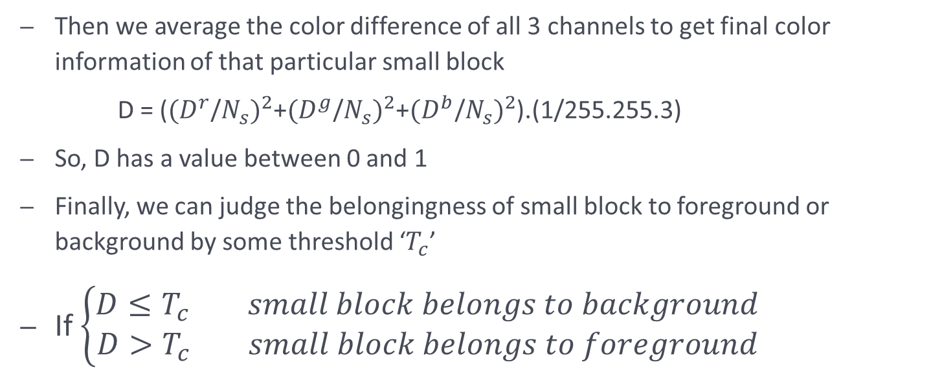
Then we average the color difference of all 3 channels to get final color information of that particular small block
D = (${(D^{r}\text{/}N_{s})}^{2}$+${(D^{g}\text{/}N_{s})}^{2}$+${(D^{b}\text{/}N_{s})}^{2}$).(1/255.255.3)
So, D has a value between 0 and 1
Finally, we can judge the belongingness of small block to foreground or background by some threshold ‘$T_{c}$’
If $\left\{\begin{aligned}D≤T_{c} small block belongs to background \\ D>T_{c} small block belongs to foreground\end{aligned}\right.$

Slide 18
INTEGRATION OF TEXTURE AND COLOR INFORMATION

Slide 19
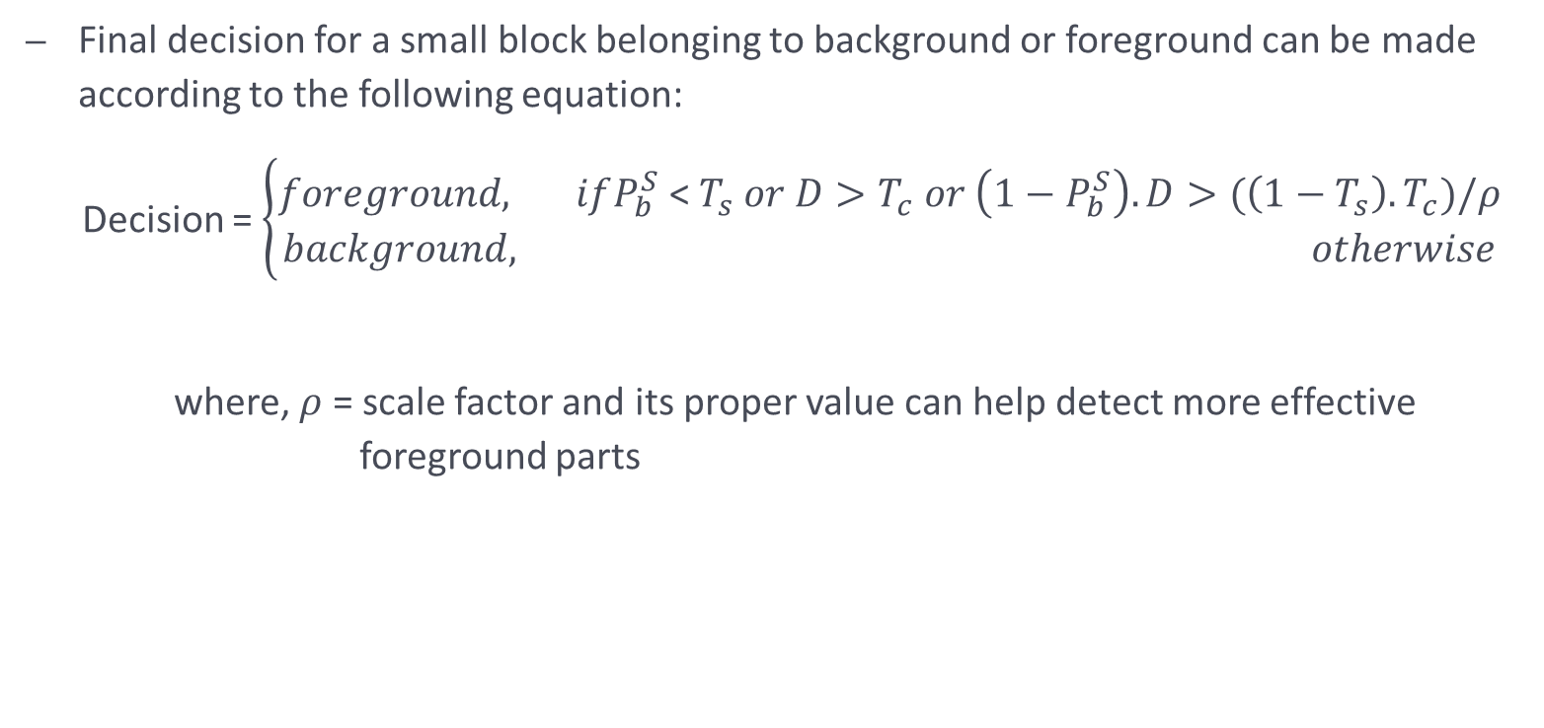
Final decision for a small block belonging to background or foreground can be made according to the following equation:
Decision = $\left\{\begin{aligned}foreground, ifP_{b}^{S} \text{<} T_{s} or D>T_{c} or \left(1−P_{b}^{S}\right).D>(\left(1−T_{s}\right).T_{c})/ρ \\ background, otherwise\end{aligned}\right.$
where, $ρ$ = scale factor and its proper value can help detect more effective foreground parts

Slide 20
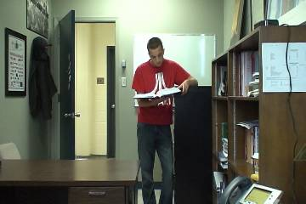
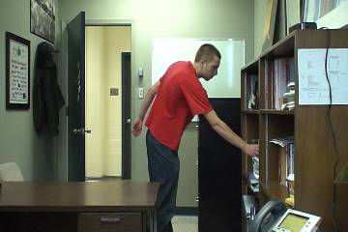
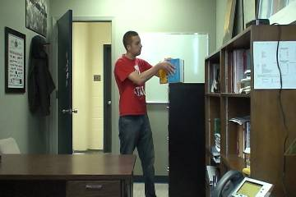

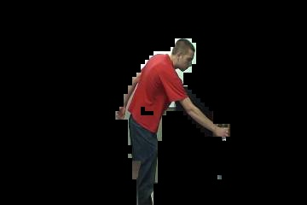
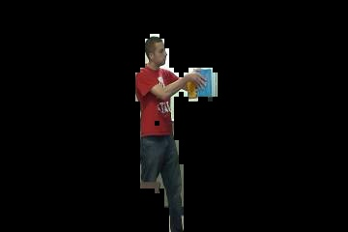
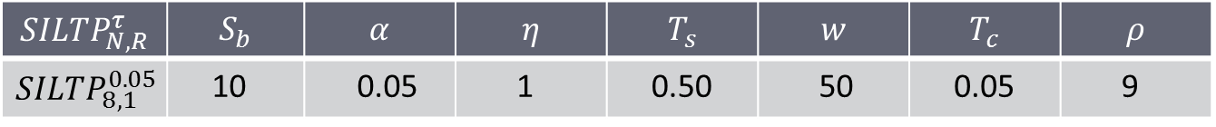
Experiment Result
$${SILTP}_{N,R}^{τ}$$ | $$S_{b}$$ | $$α$$ | $$η$$ | $$T_{s}$$ | $$w$$ | $$T_{c}$$ | $$ρ$$
$${SILTP}_{8,1}^{0.05}$$ | 10 | 0.05 | 1 | 0.50 | 50 | 0.05 | 9
The parameter values used in the experiment

Slide 21
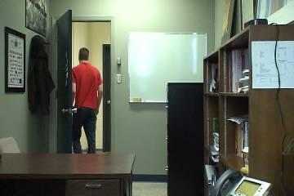
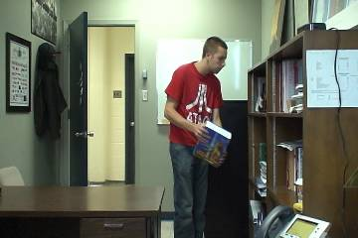
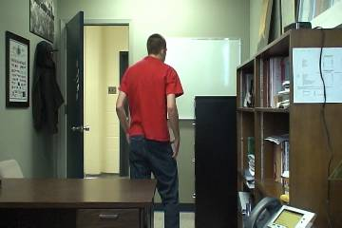

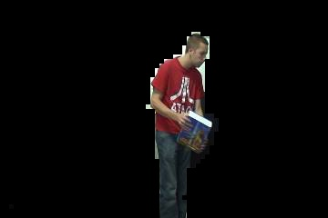
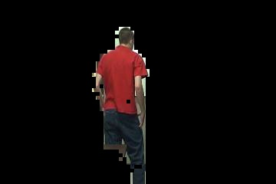
Frames from an indoor test sequence where a person is working in an office

Slide 22
THE END!

